Slide 1
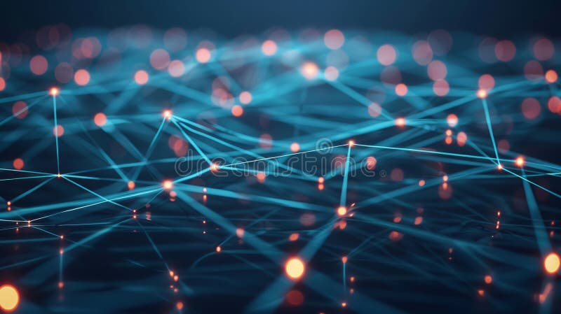
Technical Deep Dive
March 2026
The Convergence
Revolution
GNN
+
LLM
+
RAG
Unlocking the Synergy of Graph Neural Networks, Large Language Models,
and Retrieval-Augmented Generation
Structural Reasoning
Semantic Intelligence
Dynamic Knowledge
Next-Generation AI Architecture

Slide 2
Navigation
Journey Through the Convergence
01
The Triad Convergence Paradigm
02
Technical Foundations & Architecture
Understanding why GNNs, LLMs, and RAG are stronger together
How GNNs, LLMs, and RAG integrate at the architectural level
Explore the revolutionary integration of three transformative AI technologies reshaping intelligent systems
03
Leading Frameworks & Methods
04
Real-World Applications
State-of-the-art approaches driving the convergence
Where the convergence delivers transformative impact
05
Performance Breakthroughs
06
Challenges & Frontiers
Quantifying the convergence advantage
Navigating the path to mature integration
Why This Matters
The convergence addresses critical limitations of individual technologies while amplifying their collective strengths
07
The Road Ahead
Emerging trends and future directions shaping the next generation of intelligent systems
What You'll Learn
Technical foundations, breakthrough frameworks, real-world applications, and future directions

Slide 3
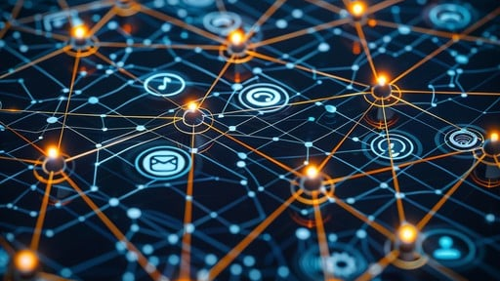
01
The Triad
Convergence
Paradigm
Understanding why GNNs, LLMs, and RAG are stronger together
Complementary Strengths
Synergistic Integration
Transformative Impact

Slide 4
The Triad Convergence Paradigm
Why This Convergence Matters
The Complementary Challenge
Performance Breakthroughs
GNNs Excel at Structure, Struggle with Language
GPT-4
Master graph topology and multi-hop reasoning but lack semantic understanding and world knowledge.
level performance
LLMs Master Language, Lack Graph Reasoning
Achieved with 7B parameter models via GNN-RAG
Understand natural language and generate text but hallucinate and cannot natively process graph structures.
8.9-15.5%
F1 improvement
RAG Provides Knowledge, Misses Relationships
On multi-hop and multi-entity questions
Retrieves relevant information dynamically but traditional vector search misses critical relational structure.
9×
token reduction
Compared to long-context inference
2×
accuracy boost
The Convergence Solution
Over standard RAG baselines
GNNs ground LLMs in structured knowledge , providing explicit reasoning paths. LLMs infuse semantic richness into graph reasoning , enabling natural language interfaces. Together they enable multi-hop reasoning with reduced hallucination , creating systems greater than the sum of their parts.
Key Insight: The convergence isn't incremental improvement—it's a paradigm shift enabling capabilities impossible for any single technology.

Slide 5
The Triad Convergence Paradigm
The Complementary Power Matrix
Graph Neural Networks (GNNs)
Retrieval-Augmented Generation (RAG)
Graph Structure Encoding
Multi-Hop Reasoning
Dynamic Knowledge Access
Captures entity relationships and topology
Traverses complex relational paths
Retrieves relevant info on-demand
Permutation Invariance
Interpretable Paths
Reduced Hallucination
Order-independent graph processing
Explicit reasoning trajectories
Grounds responses in retrieved facts
Efficient Inference
Compact Models
Domain Adaptation
<1ms-100ms response times
MBs to few GBs in size
Specializes to specific fields
Up-to-Date Information
Accesses latest knowledge
Large Language Models (LLMs)
Cost Efficiency
Natural Language Understanding
Semantic Reasoning
Reduces need for full retraining
Processes human language nuances
Captures context and meaning
Few-Shot Learning
World Knowledge
The Synergy Effect
Adapts with minimal examples
Broad pre-trained understanding
Structured + Semantic Reasoning: Combines graph topology with language understanding
Text Generation
Contextual Understanding
Grounded Generation: Produces answers with explicit graph-based evidence
Produces coherent natural language
Maintains long-range dependencies
Multi-Modal Processing: Handles text, graph, and cross-modal reasoning
Explainable AI: Provides interpretable reasoning chains

Slide 6
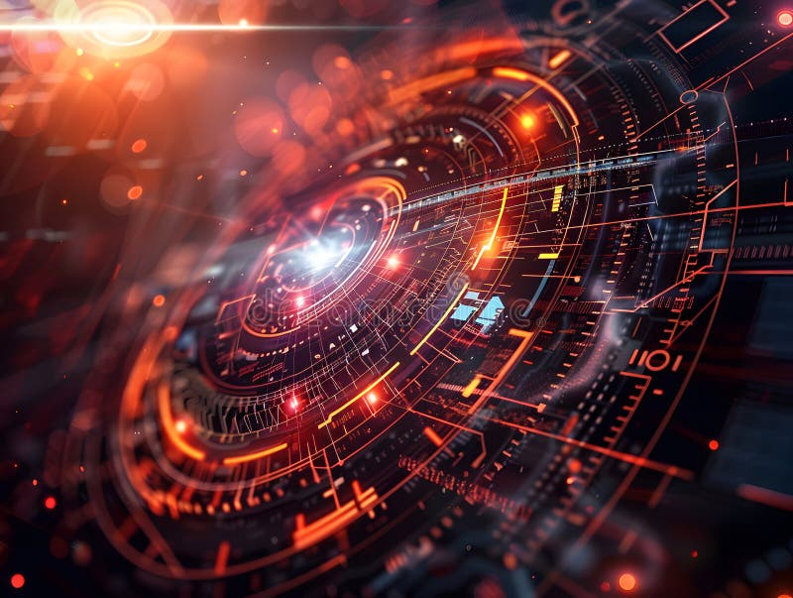
02
Technical
Foundations &
Architecture
How GNNs, LLMs, and RAG integrate at the architectural level
Integration Patterns
Data Flow
Component Design

Slide 7
Technical Foundations & Architecture
Core Integration Patterns
01
GNN-as-Retriever
02
Joint Embedding Fusion
03
Iterative Refinement
Graph Reasoning Phase
GNN-LLM Integration
LLM-Guided Generation
GNN processes dense subgraph, assigning importance weights to nodes based on question relevance and neighbor context through message passing.
Graph embeddings from GNN layers are integrated during LLM fine-tuning, creating unified representations that capture both structure and semantics.
LLM generates initial reasoning steps or hypotheses based on the question, providing semantic guidance for retrieval.
GNN Validation & Retrieval
Path Extraction
Cross-Attention Mechanisms
GNN validates generated steps against graph structure and retrieves supporting evidence, filtering out hallucinated content.
Shortest paths connecting question entities to top answer candidates are extracted to represent KG reasoning paths.
Specialized attention layers allow simultaneous processing of graph and text tokens, enabling the model to attend to both modalities.
Verbalization & RAG
Feedback Loop
Paths are converted to natural language and fed to LLM for final reasoning, combining structured evidence with semantic understanding.
Unified Representation Space
Retrieved evidence feeds back to LLM for refined generation, creating iterative improvement cycle until convergence.
Graph and text embeddings are projected into shared space, enabling seamless reasoning across modalities without explicit conversion.
Best For:
Best For:
Best For:
Knowledge graph QA, multi-hop reasoning, interpretable paths
Text-attributed graphs, multimodal reasoning, end-to-end training
Complex reasoning, hallucination reduction, high-stakes domains
Architecture Selection Framework
GNN-as-Retriever
→
Joint Fusion
→
Iterative Refinement
KG QA, Multi-hop
Multimodal, End-to-end
Complex, High-stakes

Slide 8
03
Leading
Frameworks &
Methods
State-of-the-art approaches driving the convergence
GNN-RAG
G-Retriever
GraphRAG-R1

Slide 9
Leading Frameworks & Methods
Breakthrough Frameworks
GNN-RAG
SOTA Performance
G-Retriever
2× Accuracy
Graph Neural Retrieval for LLM Reasoning
Conversational Graph QA
Core Innovation
Retrieval Strategy
PCST Algorithm
Lightweight GNN assigns importance weights to nodes based on question relevance and neighbor context
Extracts shortest paths connecting question entities to answer candidates as reasoning evidence
Prize-Collecting Steiner Tree finds optimal subgraph maximizing relevance while minimizing size
Performance Highlights
GNN-LLM Integration
WebQSP Accuracy
83.27%
CWQ F1 Score
63.48%
Integrates GNN layers during LLM fine-tuning for optimized attention on retrieved context
vs GPT-4
Matches
Multi-hop Gain
+8.9-15.5%
Conversational QA
github.com/cmavro/GNN-RAG
Enables natural language interaction with graph-structured knowledge bases
Framework Comparison
GraphRAG-R1
Deep Reasoning
Primary Use Case
KG QA / Conversational / Deep Reasoning
RL-Enhanced Graph Retrieval
Retrieval Depth
Multi-hop / Adaptive / Deep Multi-hop
RL Optimization
Deep Retrieval
Performance
Training Approach
Fine-tuning / Joint Training / RL Optimization
Process-constrained RL with custom reward schedules
Supports reasoning beyond 2-3 hop limitations
Consistent multi-point F1 improvements
Key Advantage
Efficiency / Conversational / Deep Retrieval

Slide 10
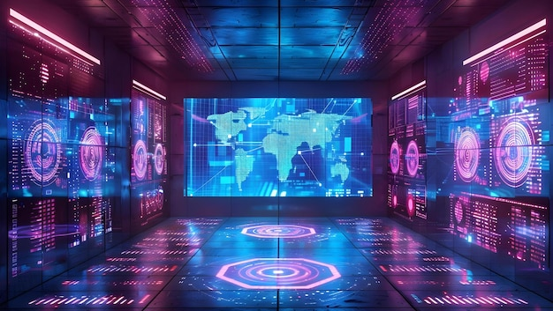
04
Real-World
Applications
Where the convergence delivers transformative impact
Healthcare
Finance
Enterprise
Recommendations

Slide 11
Real-World Applications
Domain Transformations
Healthcare & Life Sciences
Financial Services
Medical knowledge graphs & molecular discovery
Fraud detection & risk management
MedGraphRAG
Fraud Detection Systems
Improves evidence-based medical QA safety and transparency. Integrates clinical knowledge graphs with LLMs to provide grounded, explainable diagnostic support.
GNNs model transactional relationships to identify anomalous patterns indicating fraud. Sub-10ms inference with explainable reasoning paths.
GALLON Framework
LLM Contextualization
Distills multimodal molecular knowledge from LLMs into GNNs for property prediction. Combines textual descriptions, visual structures, and graph topology.
LLMs contextualize detected anomalies with descriptive analyses, enhancing alert accuracy and significantly reducing false positives.
Personalized Treatment
Transaction Graphs
Combines patient relationship graphs with LLM insights for personalized treatment recommendations based on medical history and genetic markers.
Models money flows through chains of accounts, detecting suspicious patterns invisible to traditional rule-based systems.
Impact:
Impact:
Enhanced diagnostic accuracy, accelerated drug discovery, personalized medicine
Real-time fraud prevention, explainable decisions, regulatory compliance
Enterprise Knowledge
Recommendation Systems
Organizational intelligence & policy management
Personalization at scale
GraphRAG for Enterprise
Pinterest Success
Enables complex policy queries across organizational knowledge graphs. Answers questions requiring understanding of relationships between departments.
Achieved 40% improvement in recommendation accuracy by embedding graph-derived context into LLM prompts.
Complex Query Example
Alibaba Performance
"Do we have special leave policies for cross-department projects?" — combines textual policy retrieval with graph-based relationship analysis.
Achieved 3× query performance increase using GNN-generated embeddings for product recommendations.
Explainable Recommendations
LLMs provide natural language explanations for recommendations based on graph-derived user-item interaction patterns.
Impact:
Impact:
Improved employee self-service, policy compliance, knowledge accessibility
Higher engagement, improved conversion, user trust through explanations

Slide 12
05
Performance
Breakthroughs
Quantifying the convergence advantage
Benchmark Dominance
Efficiency Gains
Robustness

Slide 13
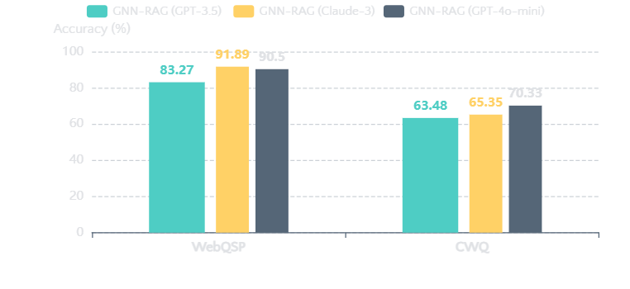
Performance Breakthroughs
Benchmark Dominance
Knowledge Graph QA Performance
Retrieval Quality Improvements
Hit@1 - PapersWithCodeQA
LeSeGR
0.827
ColBERT
0.778
Hit@1 - PubMedQA
LeSeGR
0.961
ColBERT
0.913
Generative Accuracy
LeSeGR+GPT-4
0.835
ColBERT+GPT-4
0.769
Efficiency & Scalability Gains
Robustness Under Adversarial Conditions
9×
90.7%
RoGRAD Performance
Token Reduction
Token Savings
Clean Accuracy
Worst-Case
vs long-context
cross-domain
96.29%
90.64%
28×
98%
Improvement over baselines: Up to 82.43% on Arxiv, 74.31% on Cora, 62.12% on PubMed under compound deficiencies
Inference Speed
Memory Reduction
with KG-WISE
query-aware

Slide 14
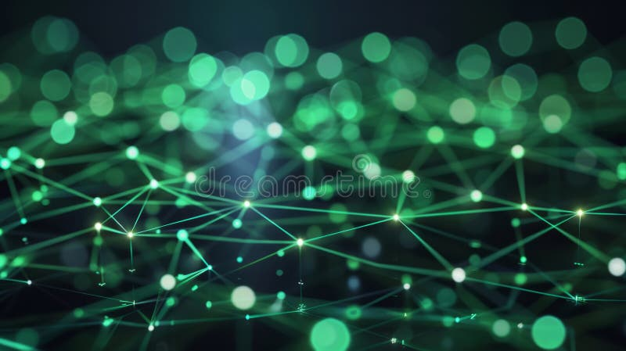
06
Challenges &
Frontiers
Navigating the path to mature integration
Scalability
Integration
Limitations

Slide 15
Challenges & Frontiers
Critical Challenges
Scalability Constraints
Integration Complexity
Token Limitations
Gradient Isolation
LLM token limits hinder effective graph representation for large-scale graphs. Encoding complex graph structures within context windows remains a fundamental bottleneck.
Production systems often disallow backpropagation through frozen LLMs due to scale/cost, limiting synergetic training signals and end-to-end optimization.
Inference Overhead
Representation Bottlenecks
Full model and complete training graph must be loaded at inference regardless of query size. This creates significant memory and computational overhead.
Simple concatenation of embeddings risks bottlenecks when scaling to dynamic graphs or evolving knowledge bases. Information loss at modality boundaries.
Cost Considerations
Domain Transfer
Despite selective invocation pipelines, LLM calls remain non-negligible. Cost scales with query complexity and retrieval depth.
Efficacy depends critically on initial language-graph vocabulary alignment. Out-of-domain adaptation remains challenging without extensive re-alignment.
Structural Limitations
Hallucination & Faithfulness
Graph Understanding
Persistent Hallucination
Current LLMs not fully conversant with arbitrary graph structure without explicit architectural modification. Permutation invariance not natively supported.
LLMs remain prone to fabricating content even with RAG augmentation. Retrieved context doesn't guarantee faithful generation.
Shallow Retrieval
Retrieval Noise
Many approaches confined to 2-3 hops. Performance degrades on problems requiring deep dependency mining beyond predefined path lengths.
Suboptimal triplet selection introduces noise that can mislead LLM reasoning. Balancing retrieval breadth with precision remains challenging.

Slide 16

07
The Road
Ahead
Emerging trends and future directions
Tighter Integration
Advanced Retrieval
Multimodal Expansion

Slide 17
The Road Ahead
Future Horizons
Tighter Architectural Integration
Advanced Retrieval Mechanisms
Multimodal Expansion
Parameter-Efficient Coupling
RL-Based Retrieval
Cross-Modal Integration
Novel adapter architectures and fusion mechanisms reducing computational overhead while maintaining expressiveness.
Reinforcement learning agents optimizing information gain with custom reward schedules balancing accuracy and efficiency.
Unified processing of text, image, audio, video with graph structures. MR-MKG demonstrates 2.25% parameter training achieving SOTA.
Memory-Efficient Hybrids
Adaptive Scoring Routes
Architectures enabling end-to-end trainability without requiring full LLM fine-tuning, reducing memory by 90%+.
Dynamic selection between dense, graph-based, or hybrid retrieval based on query complexity and domain characteristics.
Cross-Modal Reasoning
Connecting visual and textual evidence through shared graph representations for comprehensive multimodal understanding.
Theoretical Guarantees
Deep Multi-Hop Reasoning
Formal analysis of compositional generalization, establishing when and why hybrid architectures succeed.
Breaking through 2-3 hop limitations to support 5-10+ hop reasoning chains for complex knowledge graph traversal.
Unified Representations
Shared embedding spaces enabling seamless reasoning across modalities without explicit conversion or alignment.
Domain Specialization
Efficiency Breakthroughs
Industry-Specific Models
LLM-Free Inference
Expected Timeline
Fine-tuned models for healthcare (Med-PaLM 2: 85%+ USMLE), finance (BloombergGPT), legal (ChatLAW), and scientific domains.
Enriched features learned at train time and cached, enabling inference without LLM calls. SDM-InstructGLM demonstrates GNN-free graph learning.
2025
Parameter-efficient architectures, RL-based retrieval
Enterprise Integration
2026
Multimodal integration, enterprise deployment at scale
Direct embedding into business processes via Salesforce Agentforce, Microsoft 365 Copilot, and custom enterprise pipelines.
Similarity-Degree Sampling
LLM-free inference, 10+ hop reasoning, theoretical foundations
Biased random walk based on node-feature similarity and degree centrality for scalable graph encoding within token limits.
2027
Agentic Frameworks
2028+
Universal multimodal reasoning, autonomous agent ecosystems
Autonomous agents planning, executing, and adapting tasks with tool use during reasoning and parallel coordination.
Query-Aware Systems
KG-WISE demonstrates 28× inference speedup and 98% memory reduction through partial model loading and semantic subgraph retrieval.

Slide 18
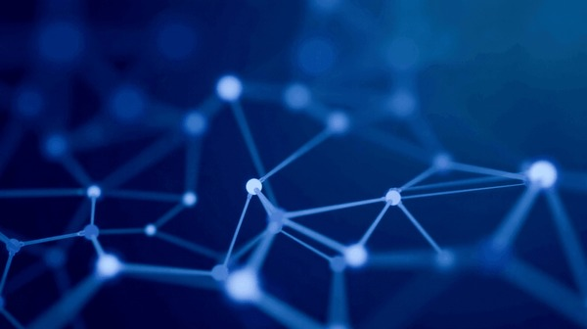
The Future is
Converged
The integration of GNNs, LLMs, and RAG represents more than technological advancement—it's a paradigm shift in how AI systems reason, retrieve, and generate knowledge.
Organizations that embrace this convergence today will lead the intelligent systems of tomorrow.
Structure
Semantics
Knowledge
Graph topology & relationships
Language & reasoning
Dynamic retrieval
The convergence revolution begins now

